Slide 1
Web Application
Using Django
Part VI

Slide 2
Allowing Users to Own Their Data
create a system to figure out which data belongs to which user
restrict access to certain pages so users can work with only their own data
modify the Topic model so every topic belongs to a specific user
Django makes it easy to restrict access to certain pages to logged-in users through the @login_required decorator
A decorator is a directive placed just before a function definition that Python applies to the function before it runs, to alter how the function code behaves

Slide 3
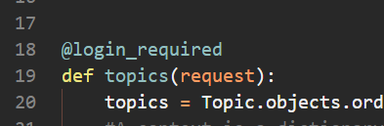
Restricting Access to the Topics Page
Each topic will be owned by a user, so only registered users can request the topics page.
Make the following changes to the learning_logs/views.py file
Import the login_required decorator and add it just before the topics view

Slide 4
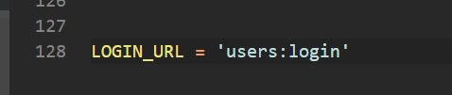
Restricting Access to the Topics Page
Topics will only be accessible if the user is logged in. If they are not logged in then they should be redirected to the login page if they click on the topic link
We need to let Django know which html file to redirect them to if they are not logged in
Add the following code to the end of settings.py file

Slide 5



Restricting Access Throughout Learning Log
to protect any page in your app, simply add the decorator before the function in the views.py file
Other than the Home page and the Registration page, lock down every page

Slide 6
Connecting Data to Certain Users
connect the data to the user who submitted it
connect only the data highest in the hierarchy to a user, and the lower-level data will follow
topics are the highest level of data in the app, and all entries are connected to a topic
As long as each topic belongs to a specific user, we can trace the ownership of each entry in the database

Slide 7
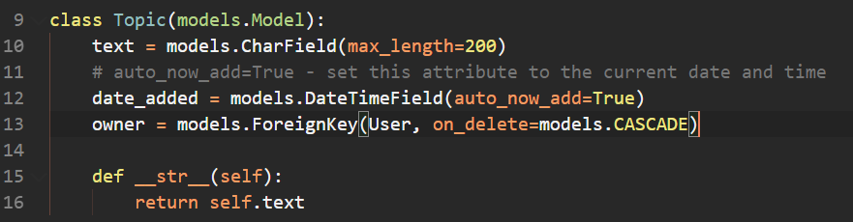
Modifying the Topic Model
modify the Topic model by adding a foreign key relationship to a user
migrate the database to make the change to the model effective

Slide 8
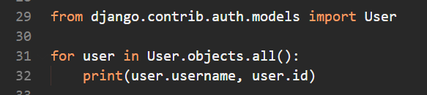

Identifying Existing Users
In order to migrate the database and make the change effective, Django will need to know which topic to assign to which user
Since each topic has to be associated to a user, to start make all topics thus far belong to the superuser
Get the ID of the superuser. Add the following code to your MyShell.py file

Slide 9
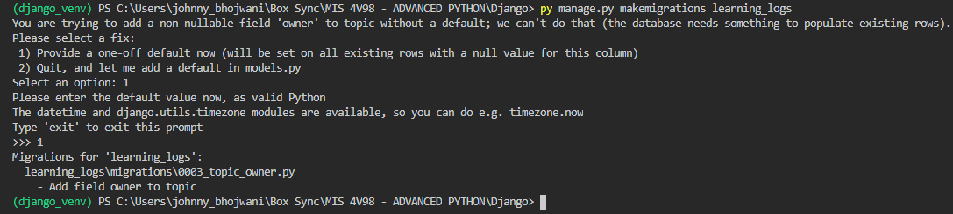
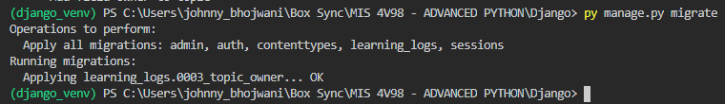
Migrating the Database
Now that we have the ID of the superuser (1), we can migrate the database.
Django will pick up the fact that a topic is associated to a user and will ask you to pick from default option or a specific value. We will choose the latter since we want to assign all topics to the superuser

Slide 10

Restricting Topics Access to Appropriate Users
change the views.py file so the user can access only the topics that belong to them
Before:
After:

Slide 11
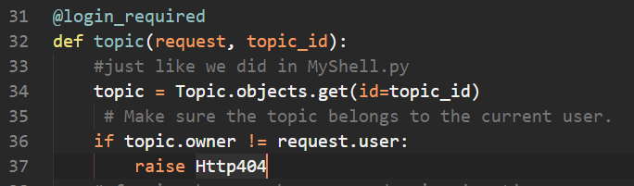
Protecting a User’s Topics
Restrict access to the topic pages. You can still reach the different pages if you know or guess the specific URL for the page
Perform a check at the topic view to see if the requestor is the owner. If it isn’t then don’t show the page

Slide 12
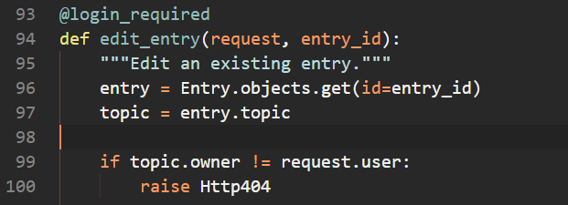
Protecting the edit_entry Page

Slide 13
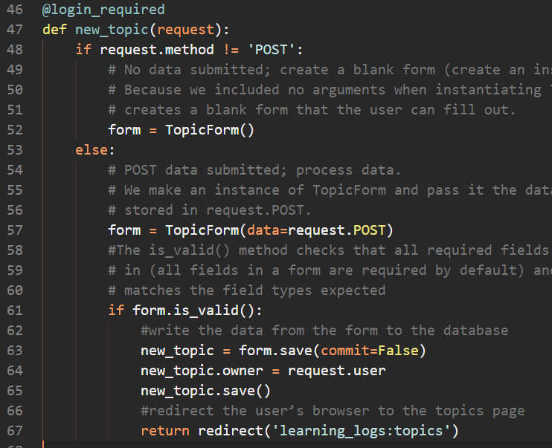
Associating New Topics with the Current User
Insert lines 63-65

Slide 14
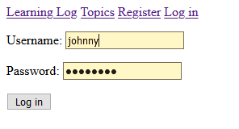
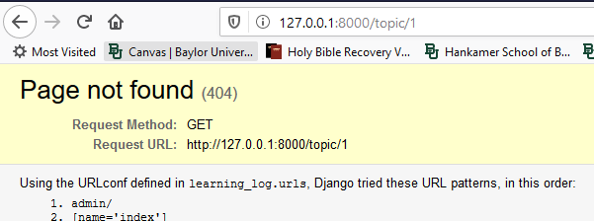
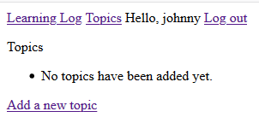
Test it Out!
Create a new user and see if you have access to any of the superuser’s topics
Use direct URLS to try and access pages directly

Slide 15
Protect the new_entry page
currently a user can go directly to the new_entry page and make an entry for another user.
To test it out, log in as a new user and type this URL in your browser - http://127.0.0.1:8000/new_entry/2/
You will have access to make a new entry into a topic that does not belong to you
Exercise – prevent this attack by checking that the current user owns the entry’s topic before saving the new entry

